Slide 1

GROUP – 19 AI BASED GENERATIVE QA SYSTEM
TEAM MEMBERS:

Slide 2
Email line generation subject
The problem offers uniqueness in having to generate extremely short, concise summary in the form of the email subject. This involves identifying the most salient sentences from the email body, and abstracting the message contained in those sentences into only a few words.
Question Answering on AIML Queries
Modeling a domain-specific that can answer the questions specific to the AIML course. It has been observed that while pretrained models can produce relevant textual output for general, open-domain textual prompts, the models lack the capability of producing finer outputs when it comes to domain-specific tasks. For this purpose, we commonly finetune the model on a dataset specific to that task, to tailor its expertise on it.

Slide 3
APPROACH/ METHODOLOGY
Tokenization
Model Selection
Fine-tuning
Metric Evaluation
Save the Model
Deployment in Streamlit

Slide 4
GPT-2
GPT-2 is a transformers model pre-trained on a very large corpus of English data in a self-supervised fashion. This means it was pretrained on the raw texts only, with no humans labelling them in any way (which is why it can use lots of publicly available data) with an automatic process to generate inputs and labels from those texts. More precisely, it was trained to guess the next word in sentences.
Bidirectional and Auto-Regressive Transformers
BART is a transformer-based sequence-to-sequence model. It utilizes both auto-regressive and bidirectional training objectives, making it effective for tasks like text summarization. The model is specifically designed to handle long sequences and has demonstrated strong performance in natural language processing tasks. Its denoising autoencoder objective during pre-training contributes to learning robust representations of input data.

Slide 5
GPT And BART Results
Metric Scores | Values
rouge_1_sub | 0.226780154
rouge_2_sub | 0.096893329
rouge_L_sub | 0.212786681
rouge_1_human | 0.430801214
rouge_2_human | 0.251932028
rouge_L_human | 0.402124561
meteor_sub | 0.229360179
meteor_human | 0.445088014
bleu_s | 6.193269365
bleu_h | 6.255868812
Metric Scores | Values
rouge_1_sub | 0.134539353
rouge_2_sub | 0.062155181
rouge_L_sub | 0.127690091
rouge_1_human | 0.250376178
rouge_2_human | 0.142701078
rouge_L_human | 0.233697819
meteor_sub | 0.173683871
meteor_human | 0.326914713

Slide 6
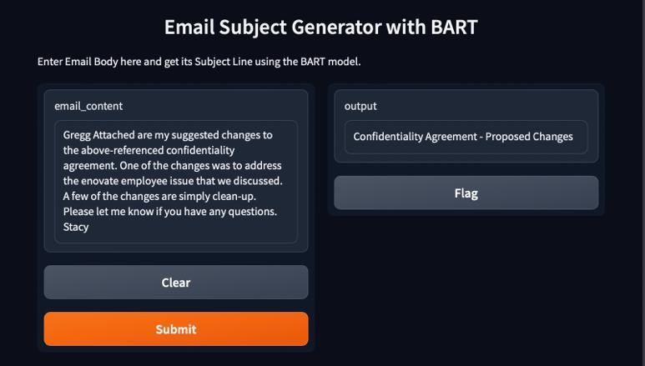
Demo of Task-1

Slide 7
Data set Preparation for task-2
We generated a set of 150 questions by carefully reviewing training materials and incorporating information from the web.
Through the assistance of ChatGPT, we refined both questions and answers by providing a single prompt for the necessary modifications.
This collaborative effort resulted in a comprehensive dataset that includes contributions from all teams, further enriched by the mentor's insights.

Slide 8
Test score results:
rouge_1: 0.26374662126122533
rouge_2: 0.09114856916939472
rouge_L: 0.227753382053244
meteor: 0.2293496569399014
bertscore_F1: 0.8656602291218248

Slide 9
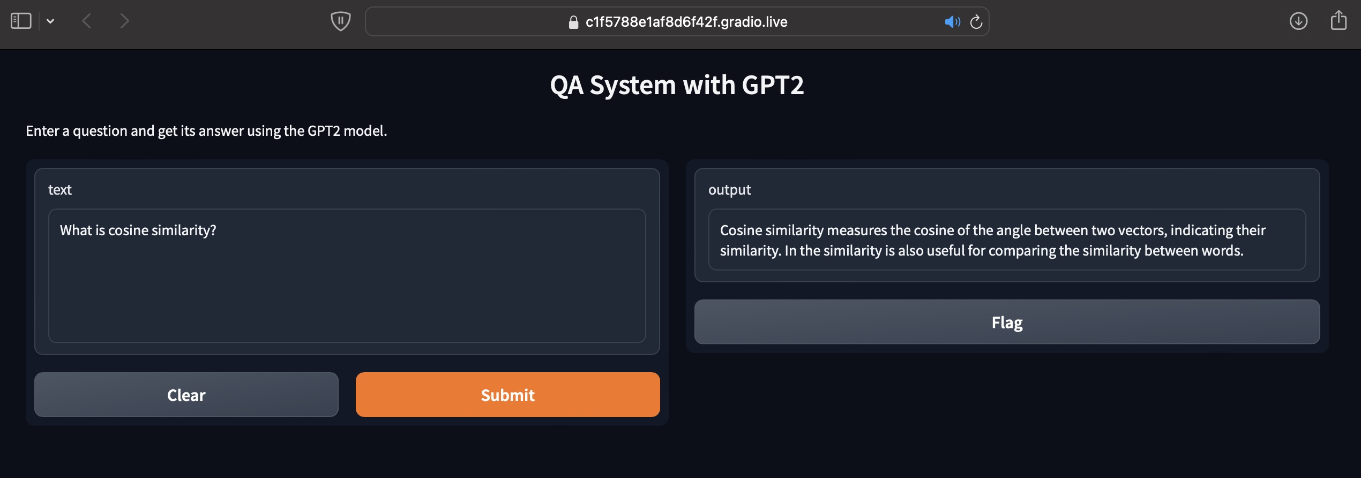
Deployment Task - 2

Slide 10
Learnings
Challenges Faced
Learned about about GPT AND BART model
Learned about Evaluation metrics like Rouge, Bleu.
Learned how deploy to code using streamlit.
Learned how to use pre trained models.
Disk space issue on collab.
Loading Model on collab take lot of time.
Email subject lines often have length constraints.

Slide 11
Application in real world:
Event Invitations and Reminders: Subject lines for event invitations, RSVP requests, and event reminders need to be clear, concise, and persuasive. Effective subject lines can increase attendance rates and engagement with event-related emails.
Transactional Emails: Subject lines for transactional emails, such as order confirmations, shipping notifications, and account updates, should provide relevant information and instill trust. Clear and informative subject lines can help recipients quickly identify and act upon transactional emails.
Healthcare Information Systems: Q&A generation technology is integrated into healthcare information systems to assist medical professionals in retrieving relevant clinical information and treatment guidelines. Clinicians can generate questions about patient symptoms, medical conditions, or treatment options to quickly access evidence-based answers and make informed decisions.
Virtual Assistants and Voice Interfaces: Virtual assistants like Siri, Alexa, and Google Assistant utilize Q&A generation to provide responses to user queries in natural language. By generating accurate and contextually relevant answers, virtual assistants enhance user interactions and provide personalized assistance.
Customer Support Chatbots: Many businesses deploy chatbots equipped with Q&A generation capabilities to provide instant responses to customer inquiries. These chatbots can answer frequently asked questions, troubleshoot common issues, and guide users through product features or processes.

Slide 12


